Slide 1
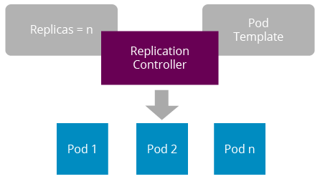
A
MINOR PROJECT
ON
K8S REPLICATION CONTROLLER
SUBMIT BY :-
RINKU SHARMA
SUBMIT TO :-
ASHISH MITTAL

Slide 2
Table to content
What is replication controller
Replication controller feature
How replication controller works
Scaling with replication controller
Hands on practice

Slide 3
What is replication controller
Replication Controller is a core component of Kubernetes.
It ensures that a specified number of identical pods are always running.
It monitors pod health and automatically replaces failed or terminated pods.
Helps achieve high availability, scalability, and fault tolerance in Kubernetes clusters

Slide 4
Replication controller feature
Automatic Scaling: Allows scaling the number of replicas up or down based on defined rules.
Pod Template Management: Defines the desired state of the pods using a template.
Self-Healing: Monitors the health of pods and replaces failed or terminated pods automatically.
Rolling Updates: Enables rolling deployments by gradually replacing old pods with new ones.
Label-Based Selection: Uses labels to identify and manage groups of pods.

Slide 5
How replication controller works
User specifies the desired number of replicas in the Replication Controller configuration.
Replication Controller continuously monitors the actual number of running pods.
If there are fewer pods than desired, it creates new replicas to match the desired count.
If there are excess pods, it terminates the extra ones until the desired count is reached.
Monitors pod health by constantly checking their status.

Slide 6
Scaling with replication controller
Explaining scaling up and down using the Replication Controller:
Scaling Up: Increase the replica count to handle increased demand.
Scaling Down: Decrease the replica count during periods of low demand.
Demonstrating scaling commands: kubectl scale rc my-replication-controller --replicas=5

Slide 7
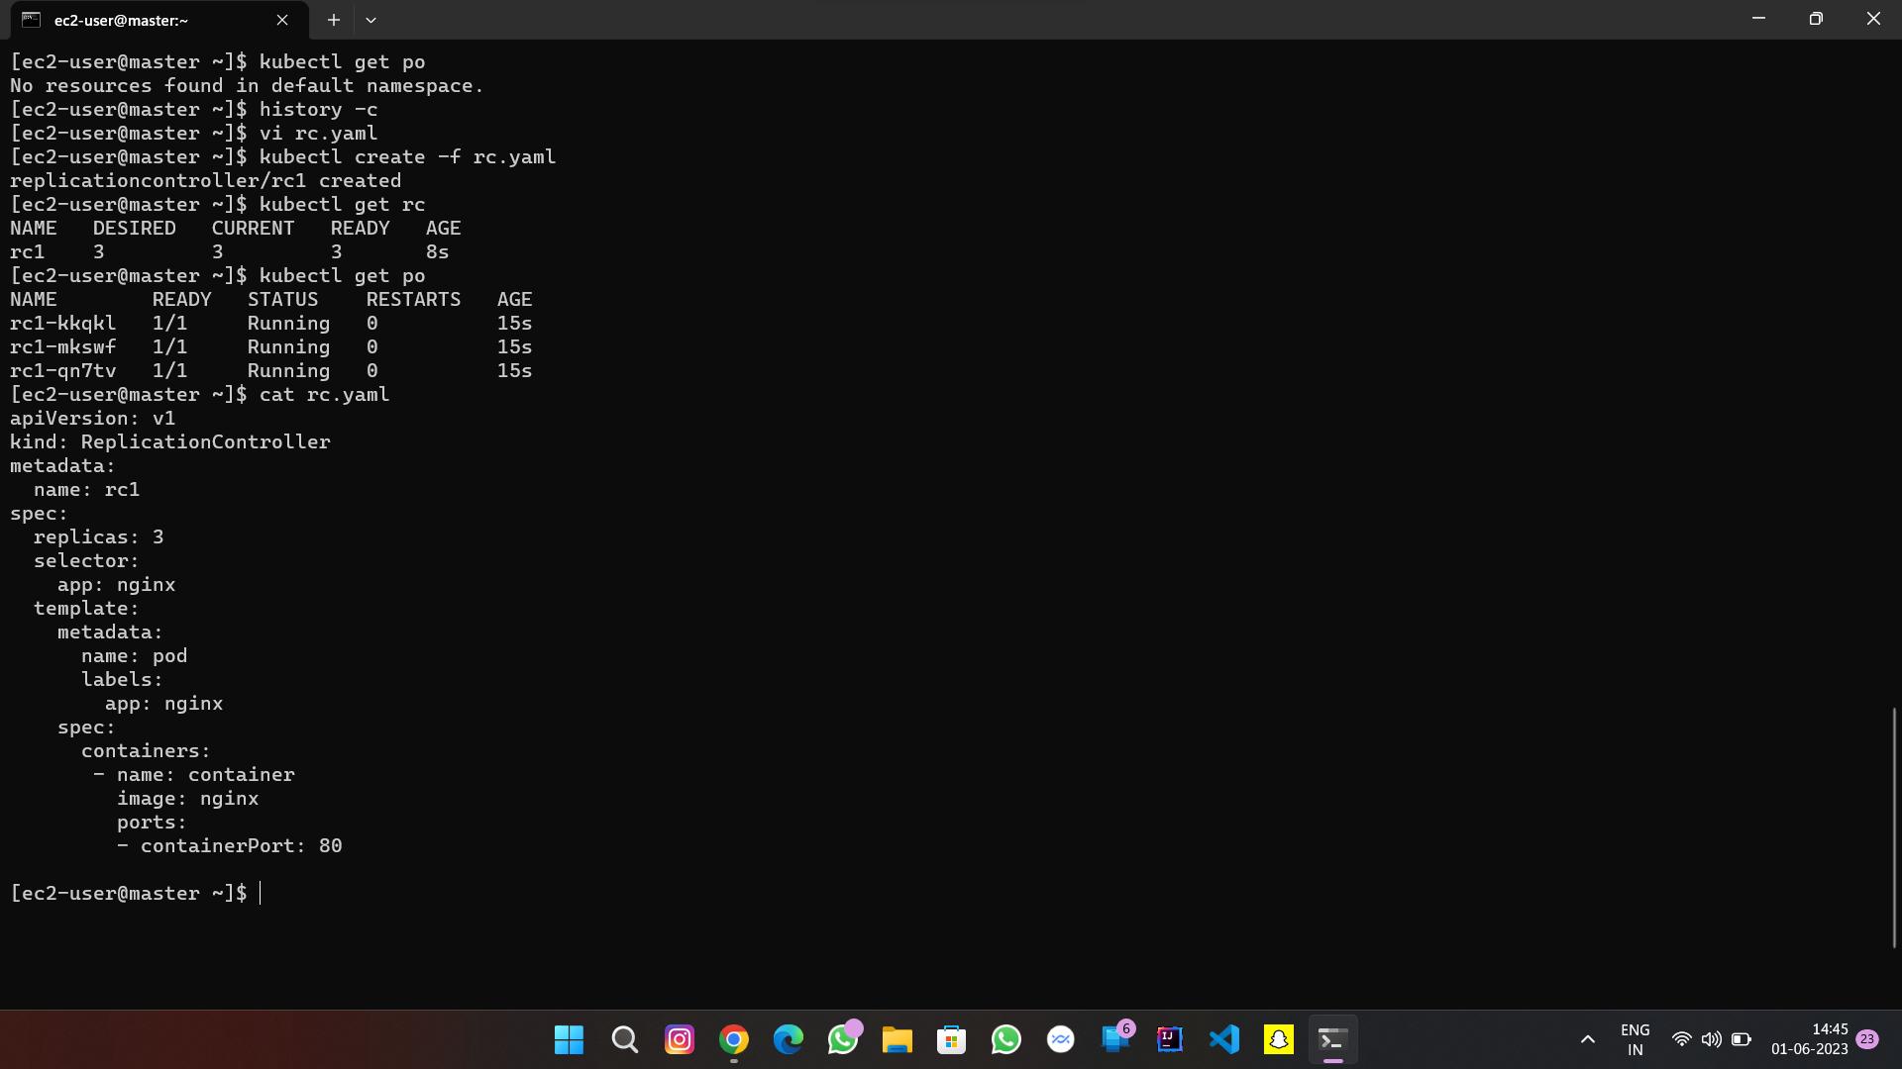
Hands on practice

Slide 8
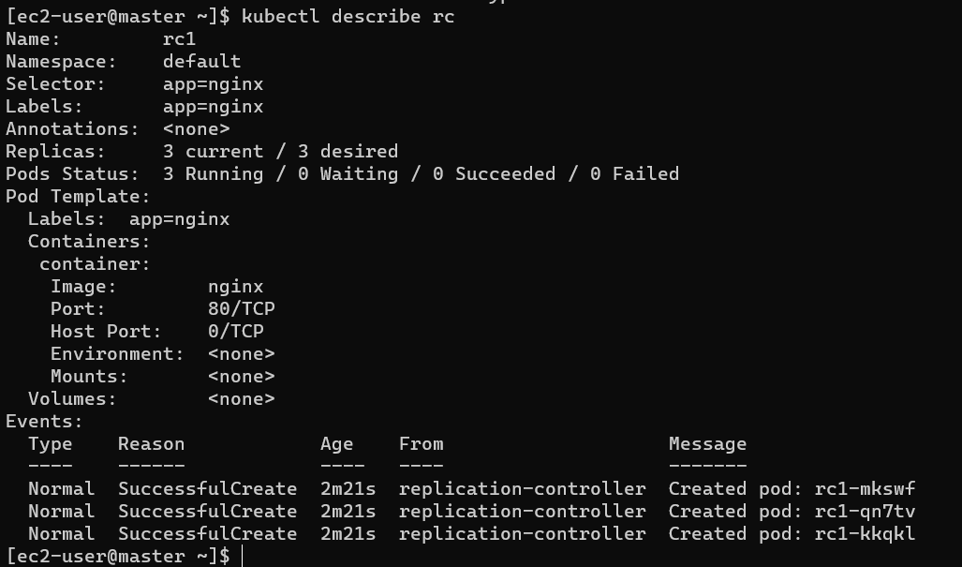

Slide 9
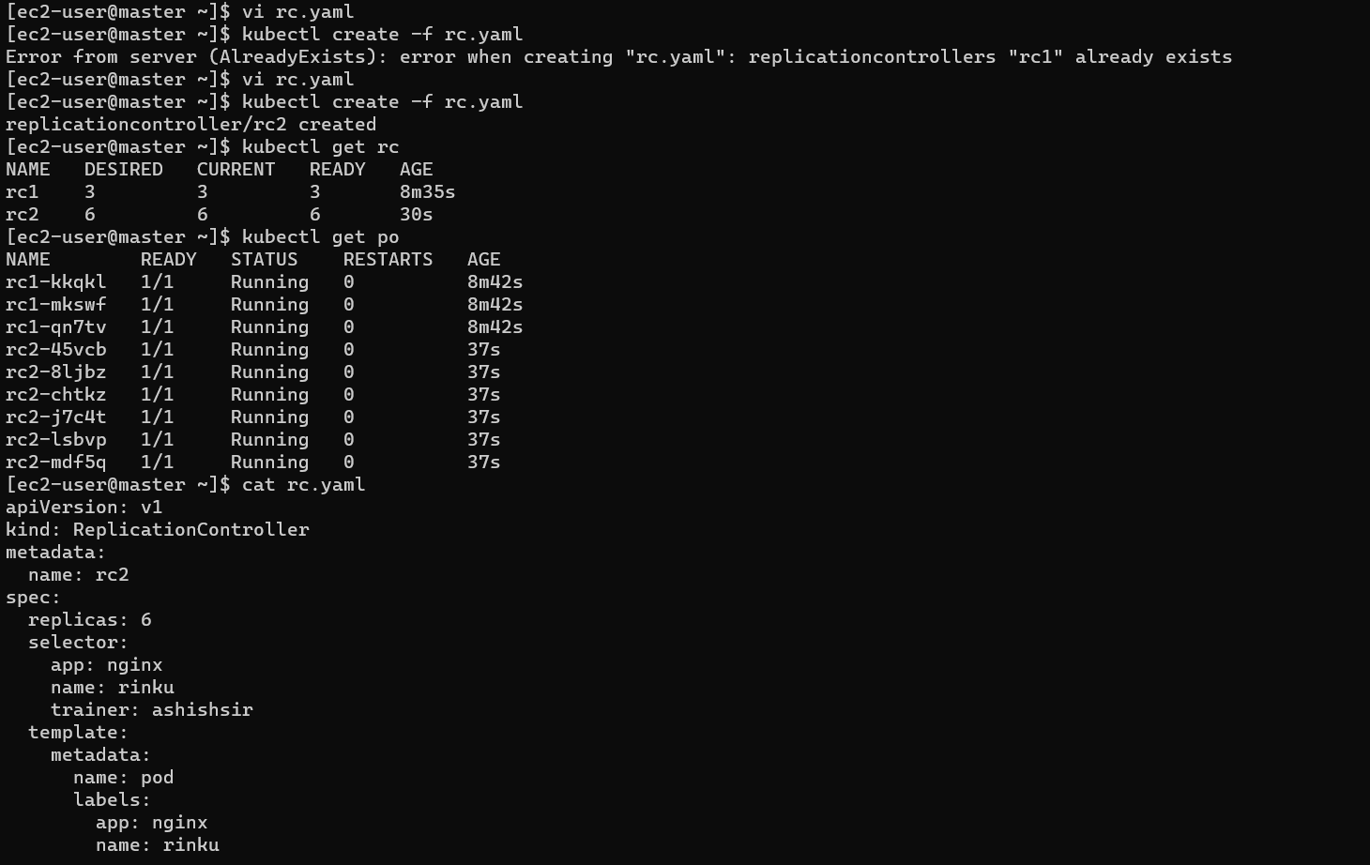

Slide 10
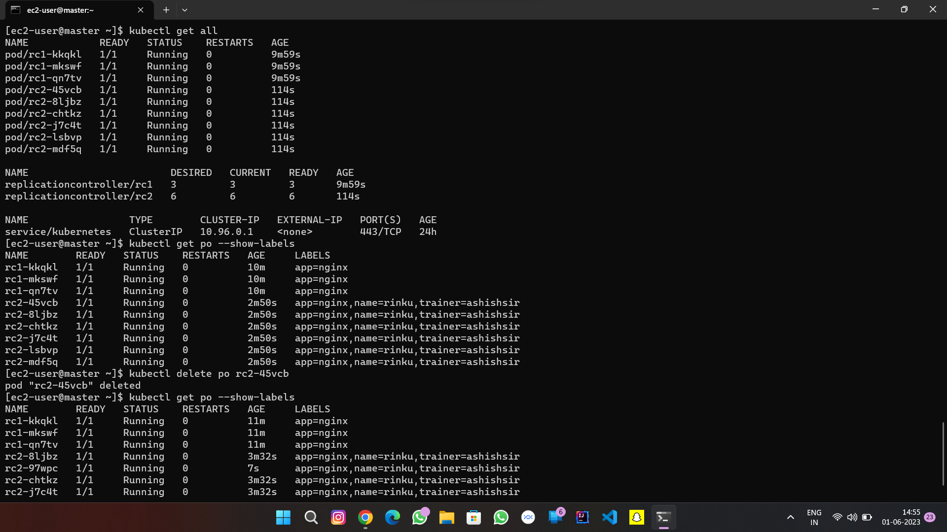

Slide 11
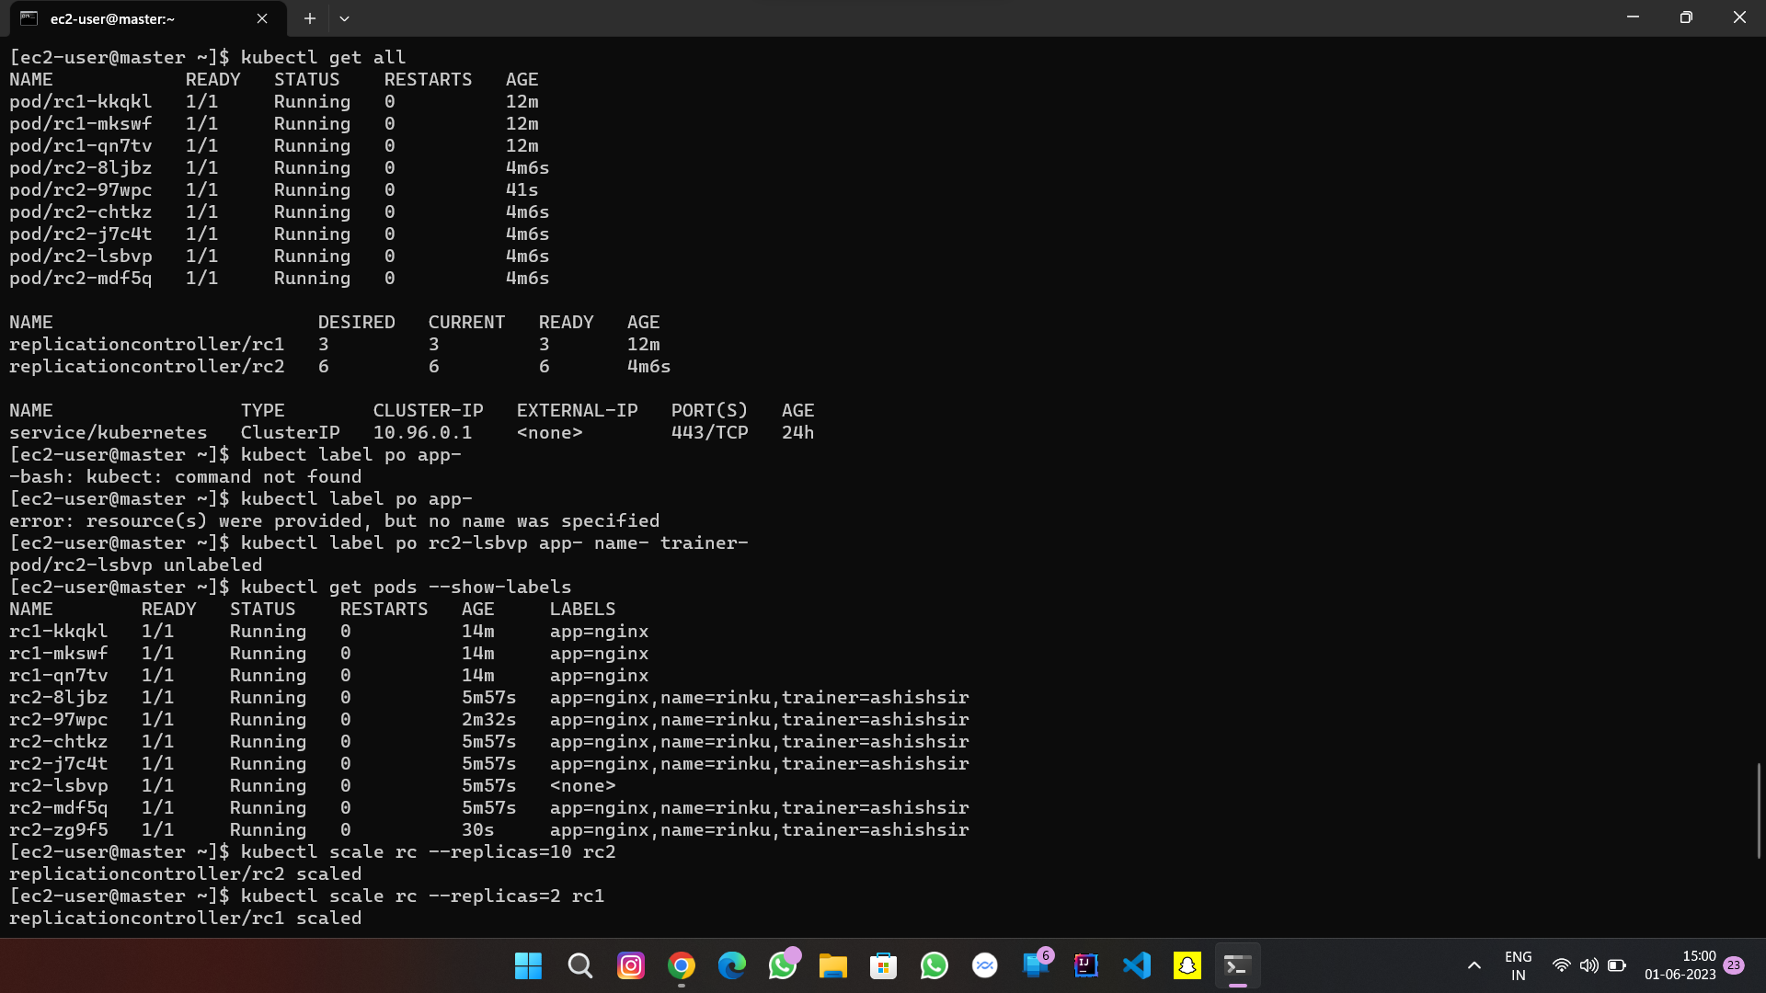

Slide 12
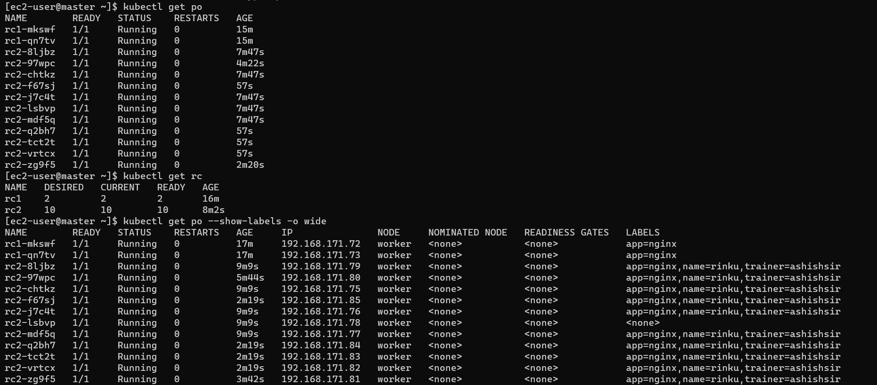

Slide 13
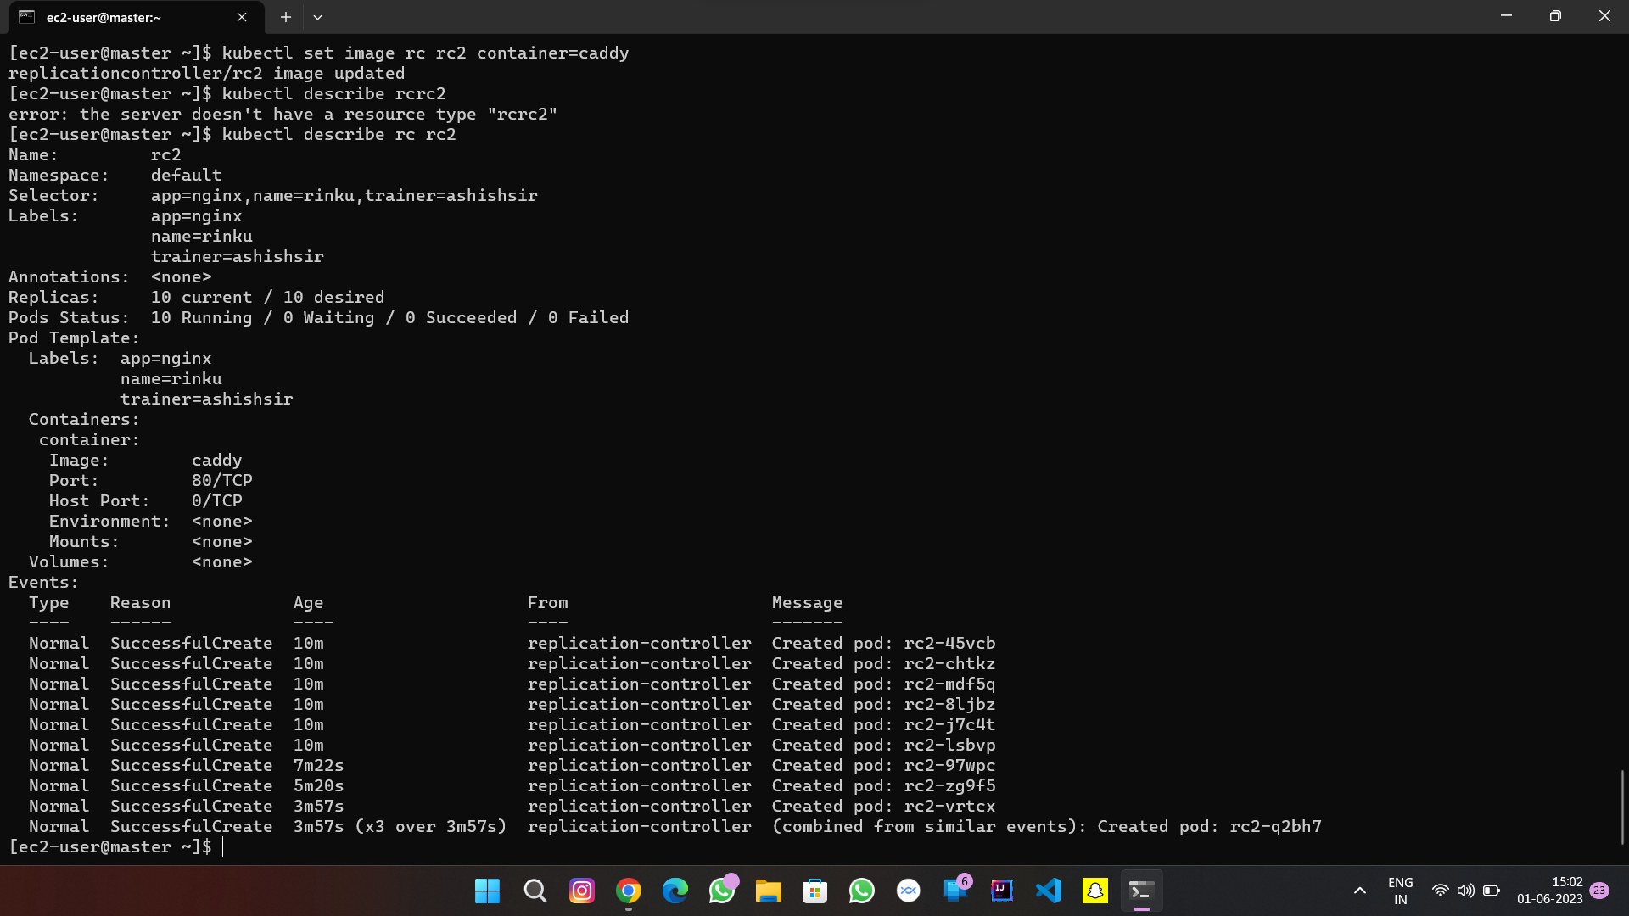

Slide 14
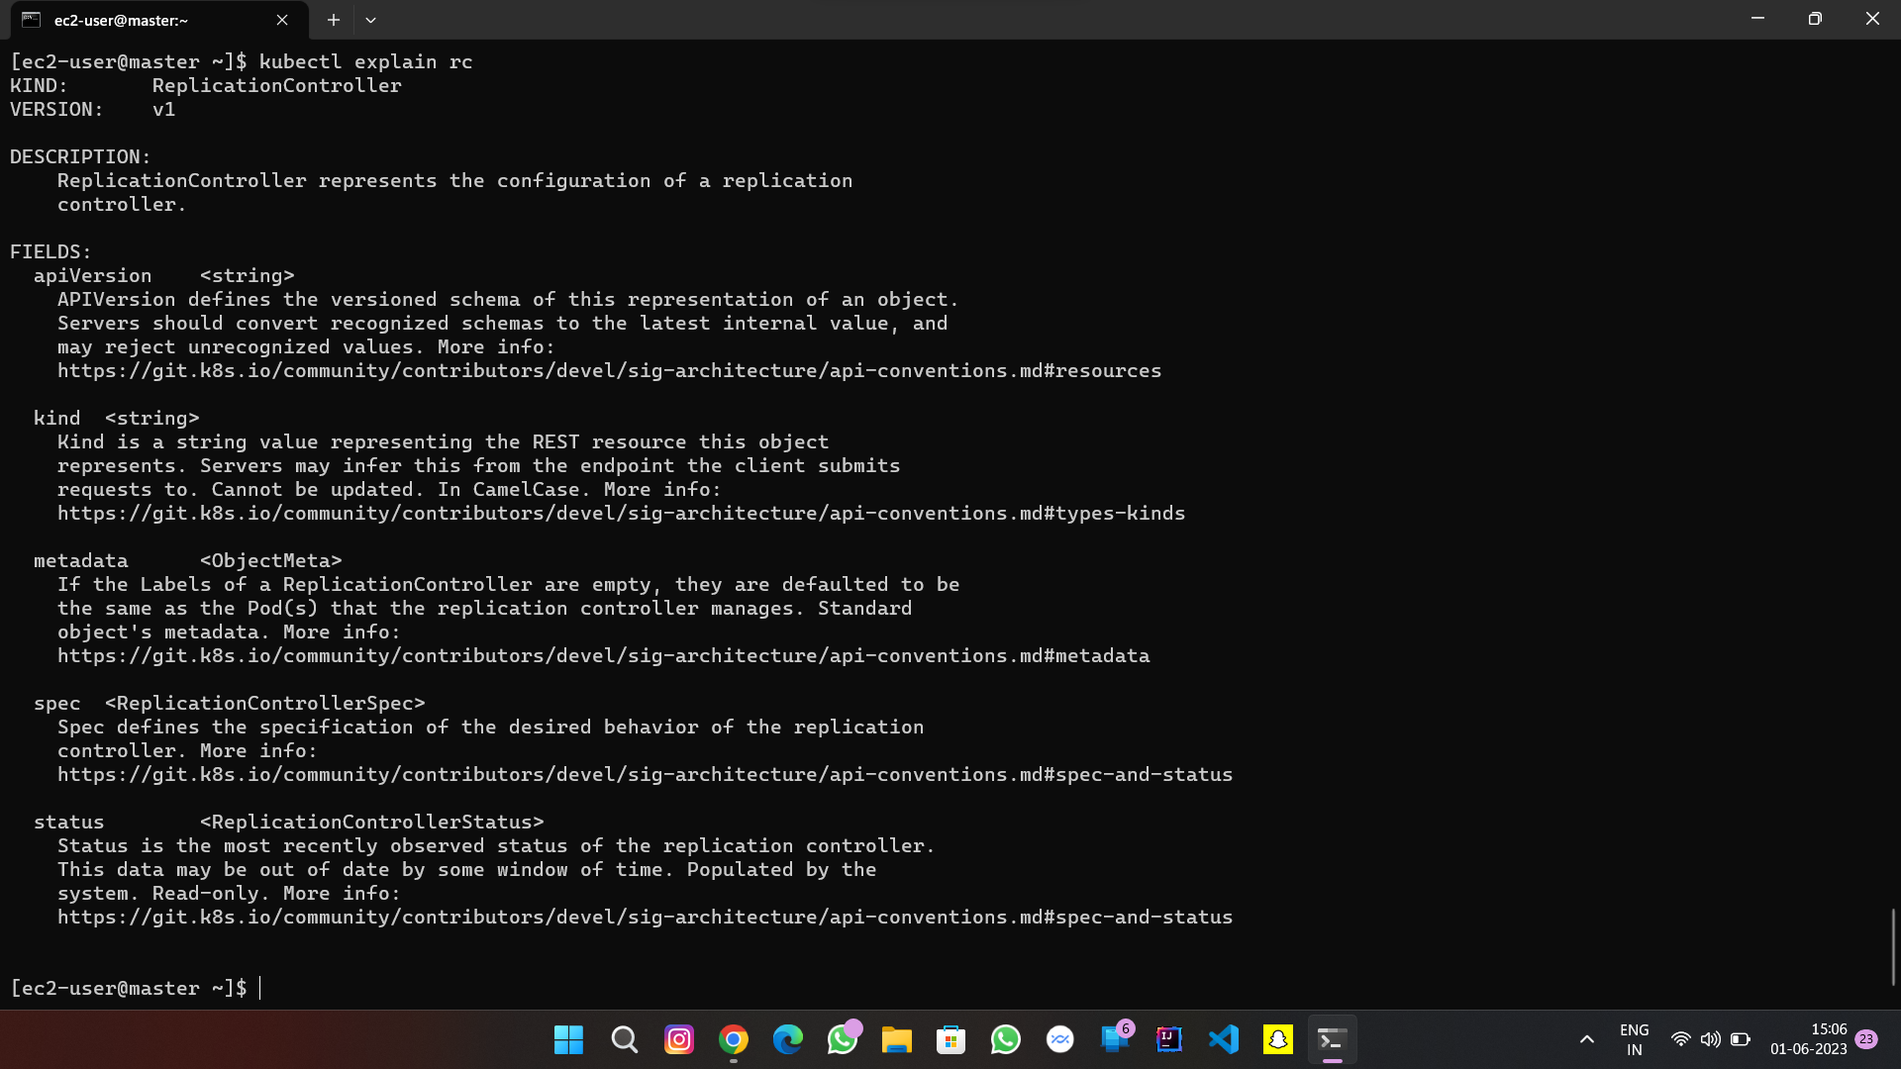

Slide 15
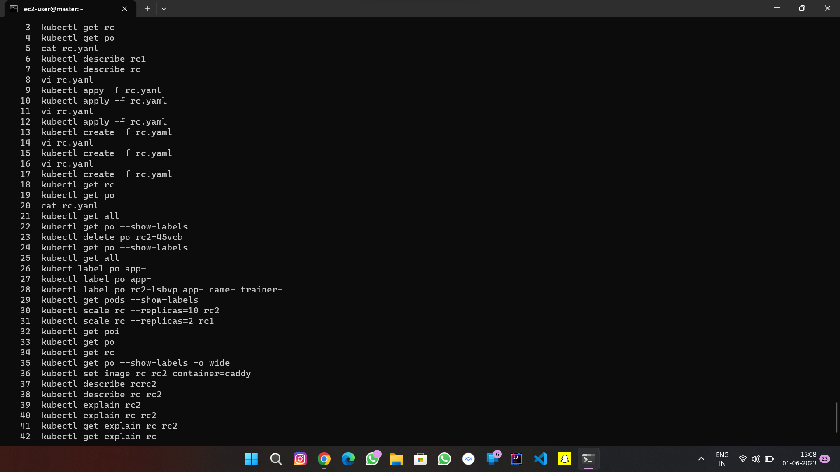

Slide 16


